Slide 1
ENSE 477 Scrum Report-Out
ZAM
Zain Abedin . Alwin Baby . Muhammad Ahmed
14-Jan-2020

Slide 2
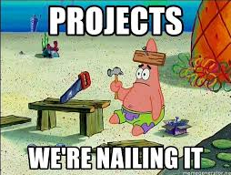
Project deats
What are we creating
Web application platform for Lab Safety, Training and Inspection.
One platform to manage and track inspections, safety hazard info ,training manuals/videos
Other softwares lack integration, features not specific to the academic industry, expensive

Slide 3

Progress review
What are you currently working on?
Architectural Design
Implementing Back End
Implementing Front End Skeleton & Behaviour
- Vue.js + Veutify
GitHub
Repo

Slide 4
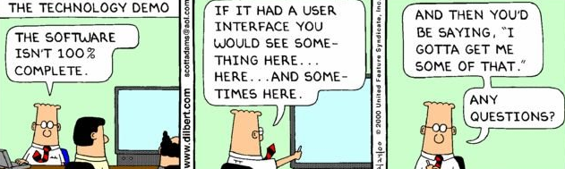
Project demo
localhost

Slide 5

Group reflection
Do you feel you are on track?
Yes, we think we are on track
Asana - for project management(task assignment, milestones ,etc.)
Do you need any help going forward?
Architecture/Security/Scalability/Future Verisoning
Any other questions or concerns?
None at the moment

Slide 6
Image refs
Show me what you got, https://pictures.abebooks.com/isbn/9781548899530-us-300.jpg
Patrick, https://imgflip.com/memetemplate/43274976/spongebob-patrick-nail-saw
Dilbert, http://4.bp.blogspot.com/-tVbJsudDNaw/T29WxQ0PHZI/AAAAAAAAABc/UlTwD2gkzA4/s1600/Dilbert%2520Software%2520Demo%5B1%5D.jpg
Pondering, https://imgflip.com/s/meme/Question-Rage-Face.jpg

